Slide 1
Governança Terminologias Clínicas
Oficina FHIR – Projeto IPS
15 de março de 2023

Slide 2
Agenda
Estados Unidos - ONC
Inglaterra - NHS
Australia – Digital health Australia

Slide 3
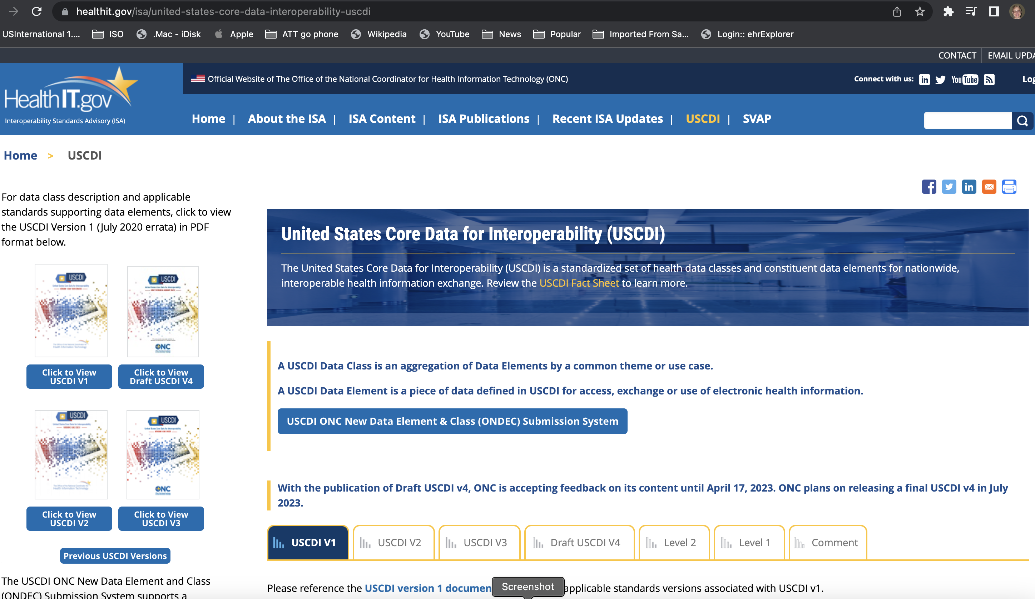
Estados Unidos
https://www.healthit.gov/isa/united-states-core-data-interoperability-uscdi

Slide 4
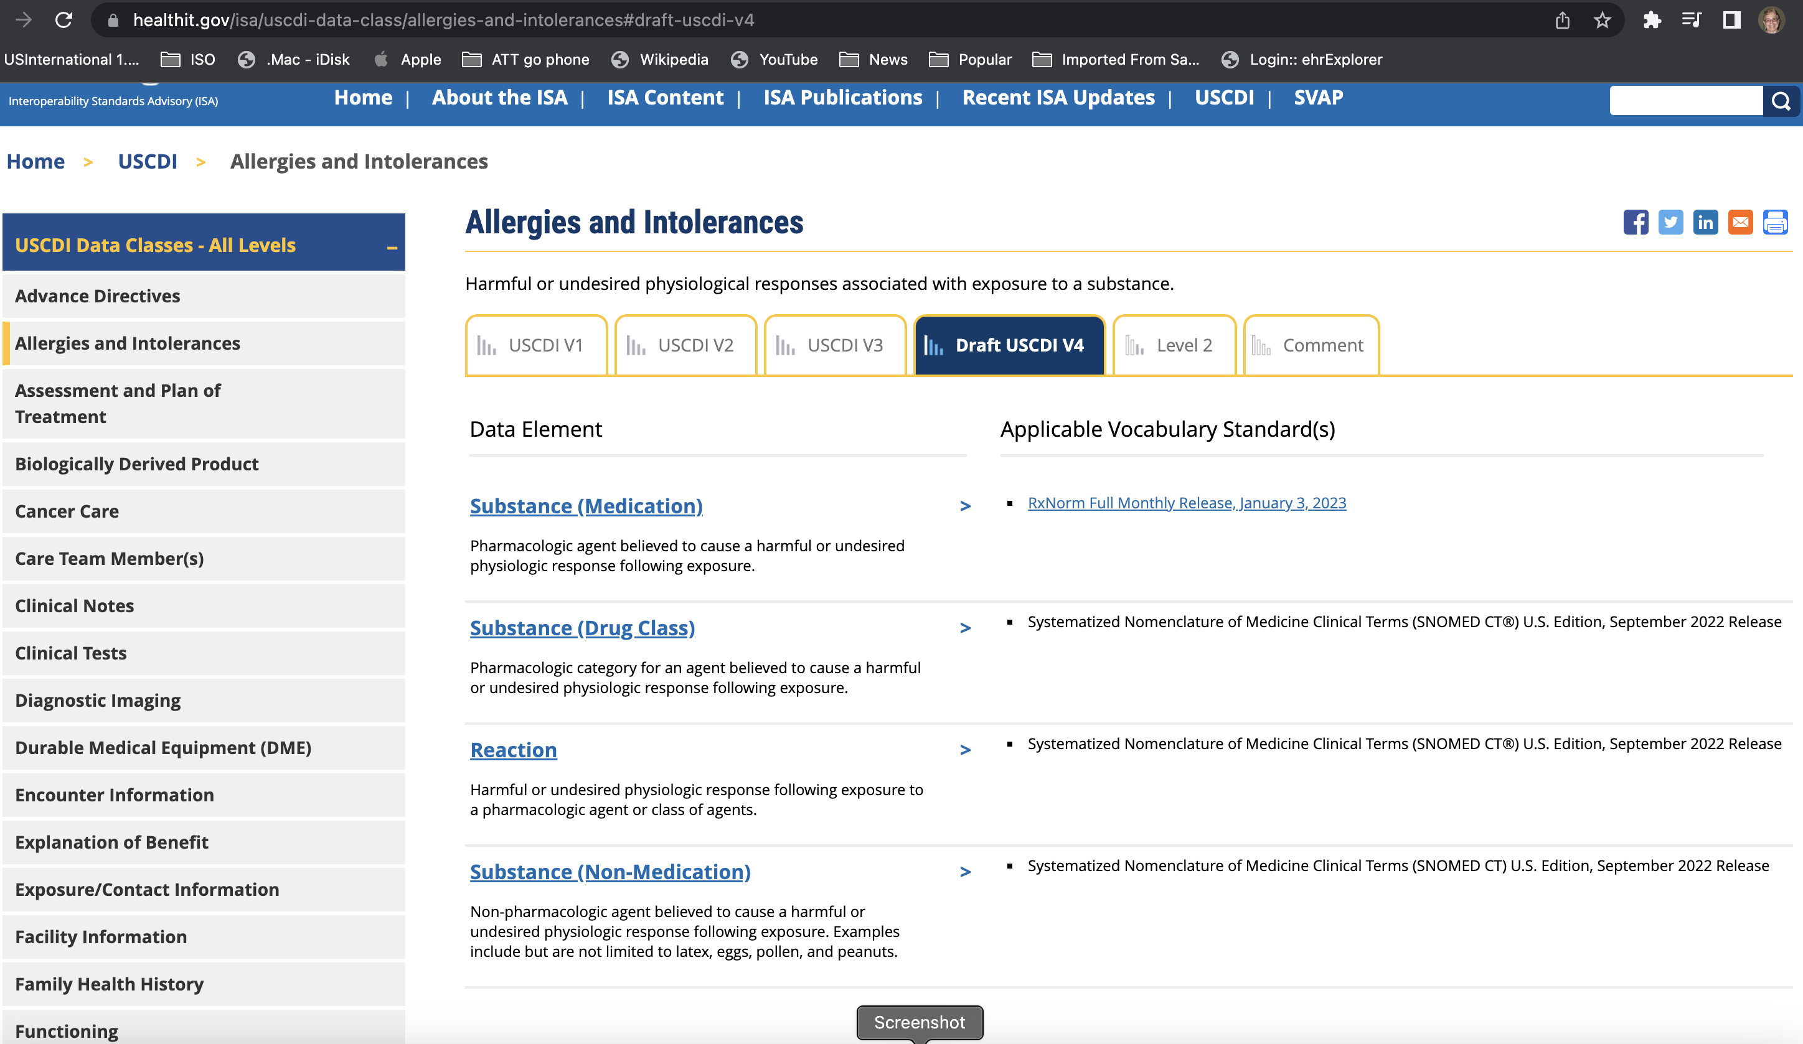
https://www.healthit.gov/isa/uscdi-data-class/allergies-and-intolerances#draft-uscdi-v4

Slide 5
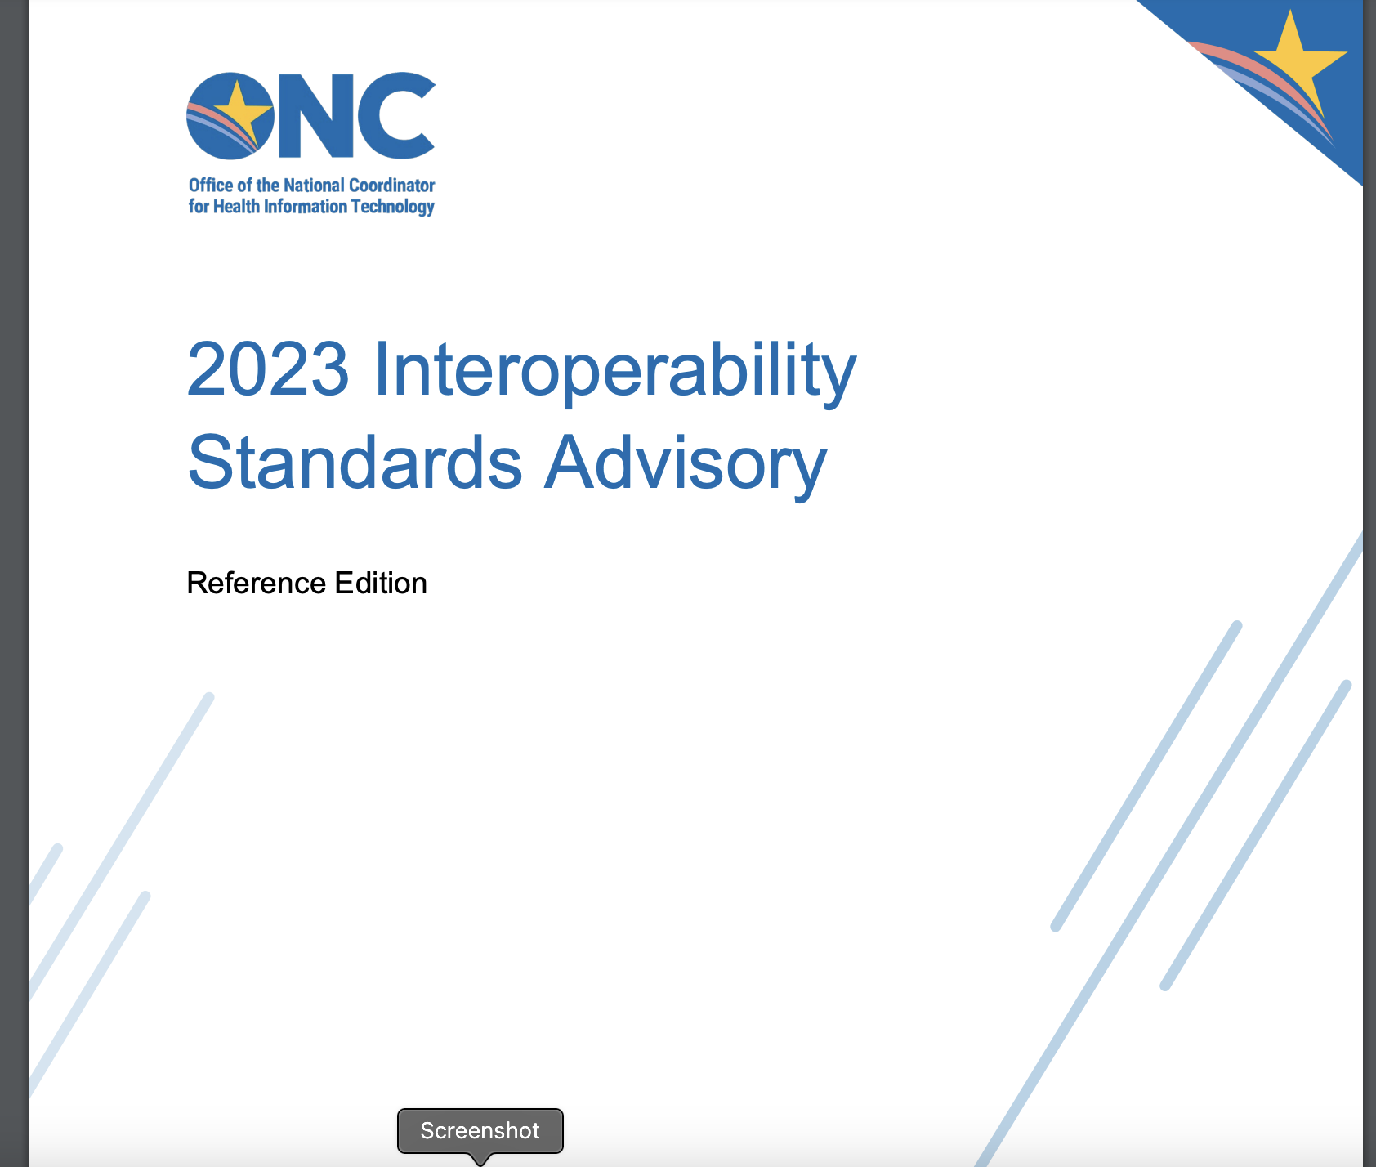
https://www.healthit.gov/sites/isa/files/inline-files/2023%20Reference%20Edition_ISA_508.pdf

Slide 6
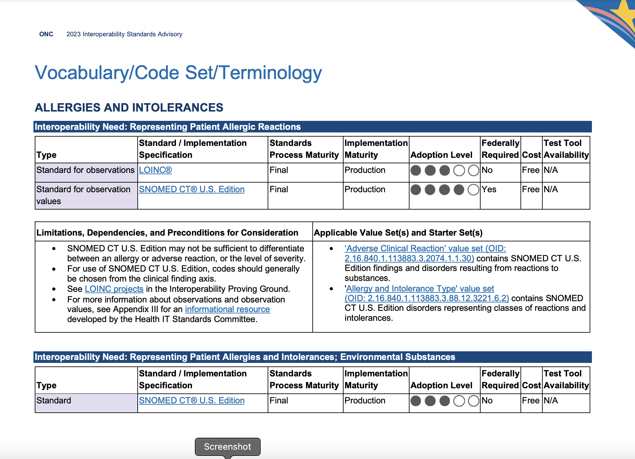
https://www.healthit.gov/sites/isa/files/inline-files/2023%20Reference%20Edition_ISA_508.pdf

Slide 7
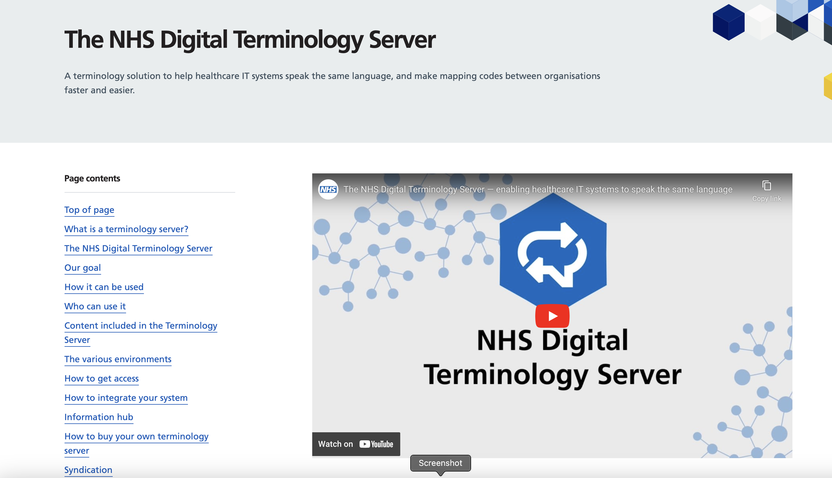
https://digital.nhs.uk/services/terminology-servers

Slide 8
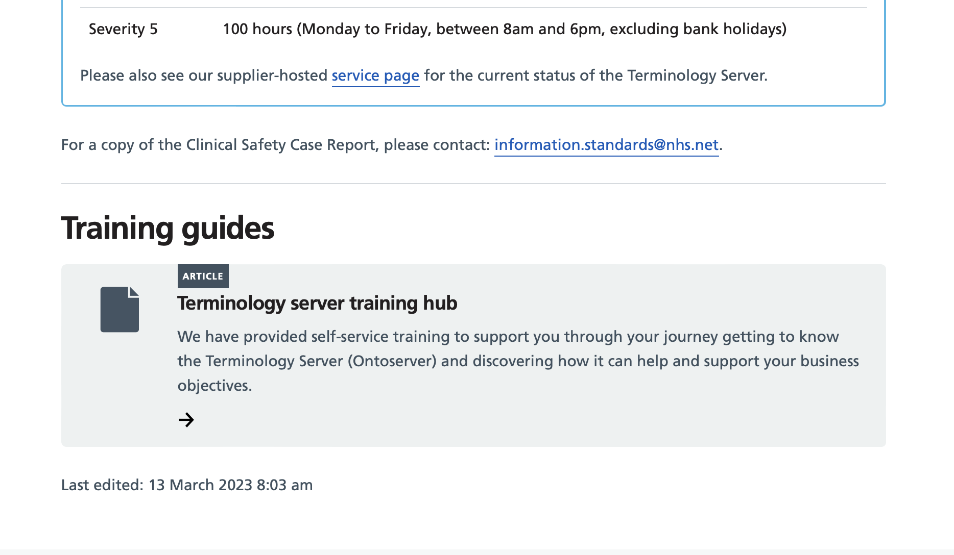
https://digital.nhs.uk/services/terminology-servers#training-guides

Slide 9
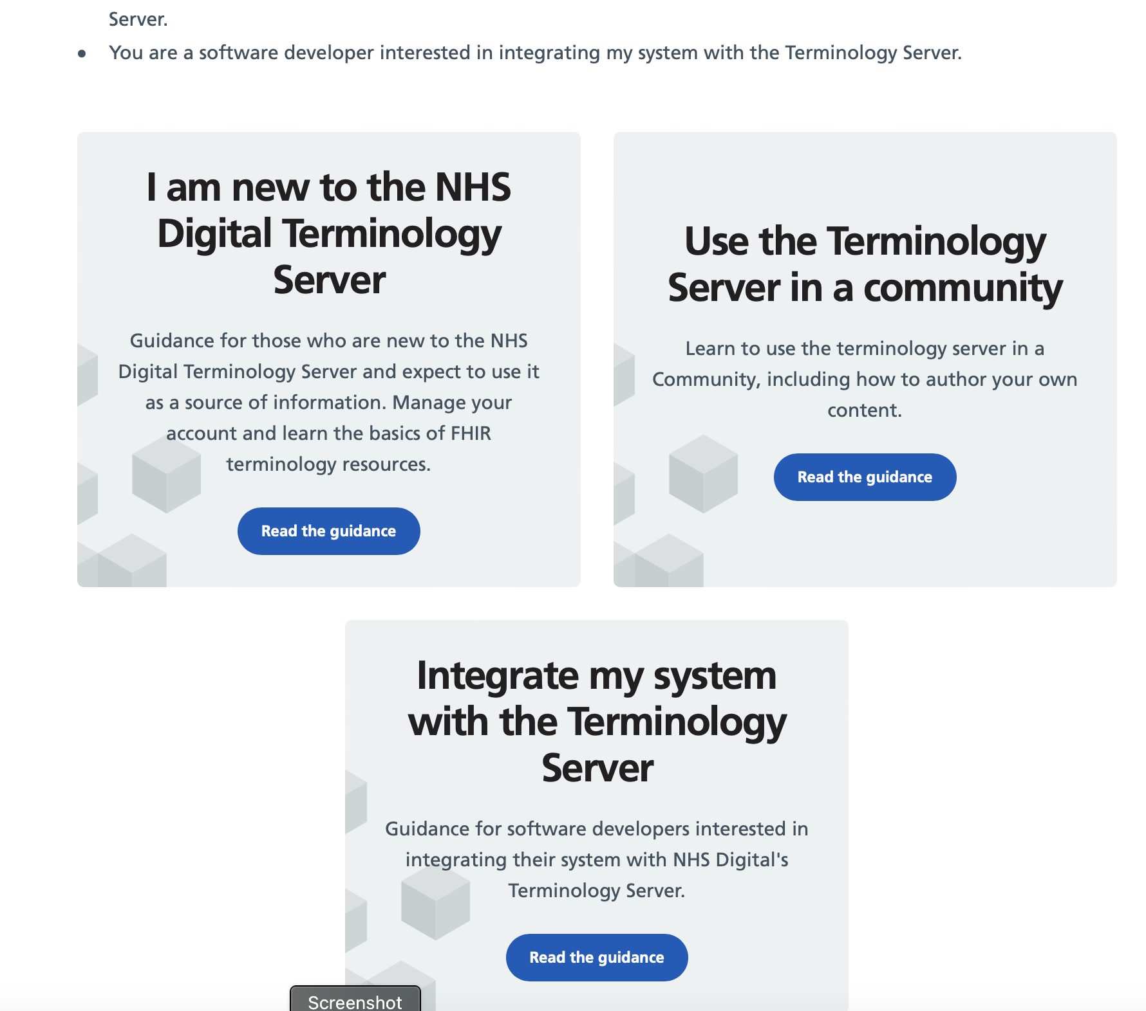
https://digital.nhs.uk/services/terminology-servers

Slide 10
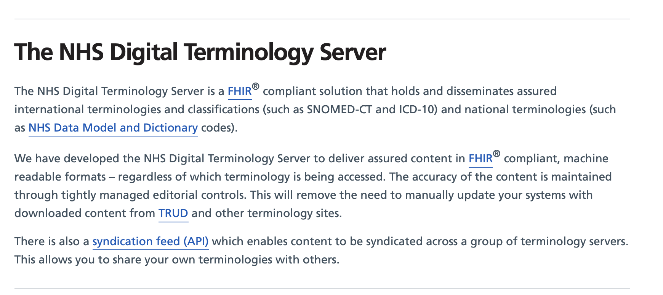

Slide 11
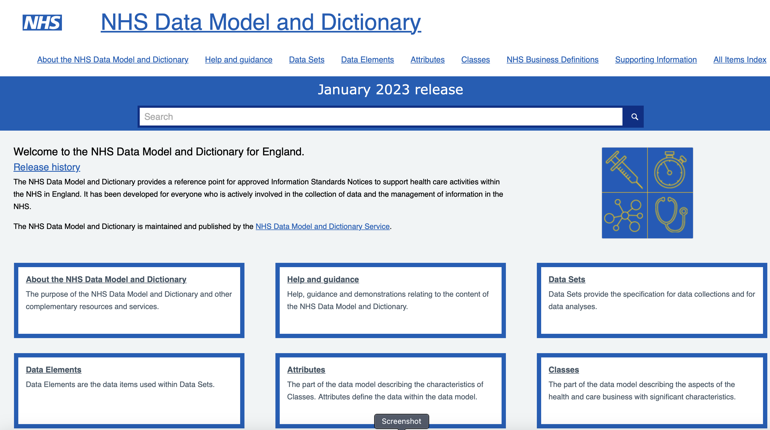
https://www.datadictionary.nhs.uk/index.htm

Slide 12
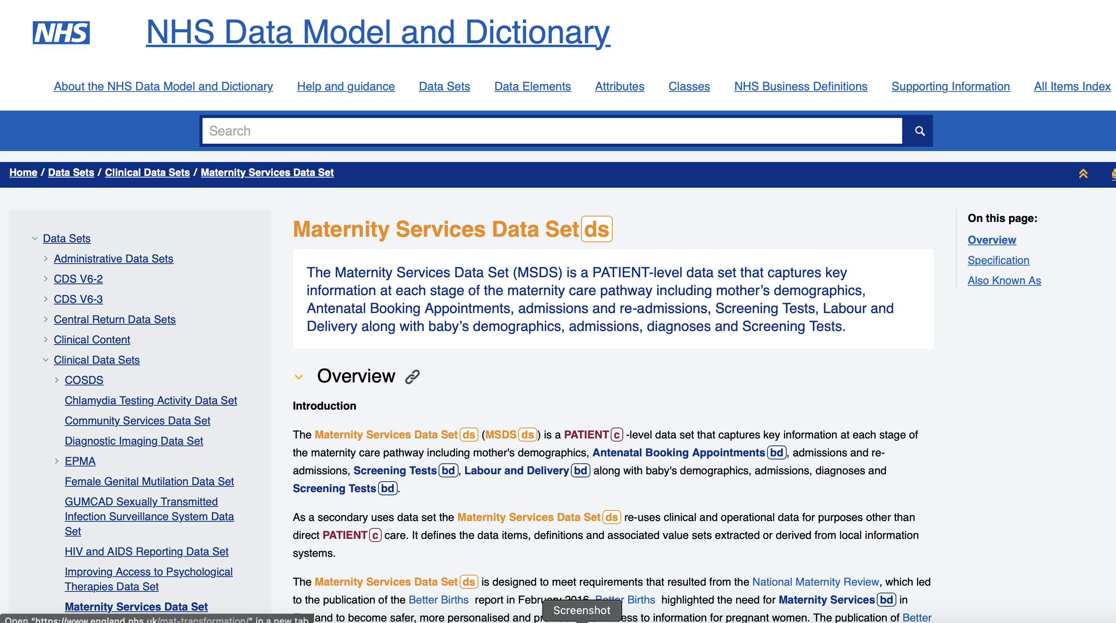
https://www.datadictionary.nhs.uk/data_sets/clinical_data_sets/maternity_services_data_set.html

Slide 13
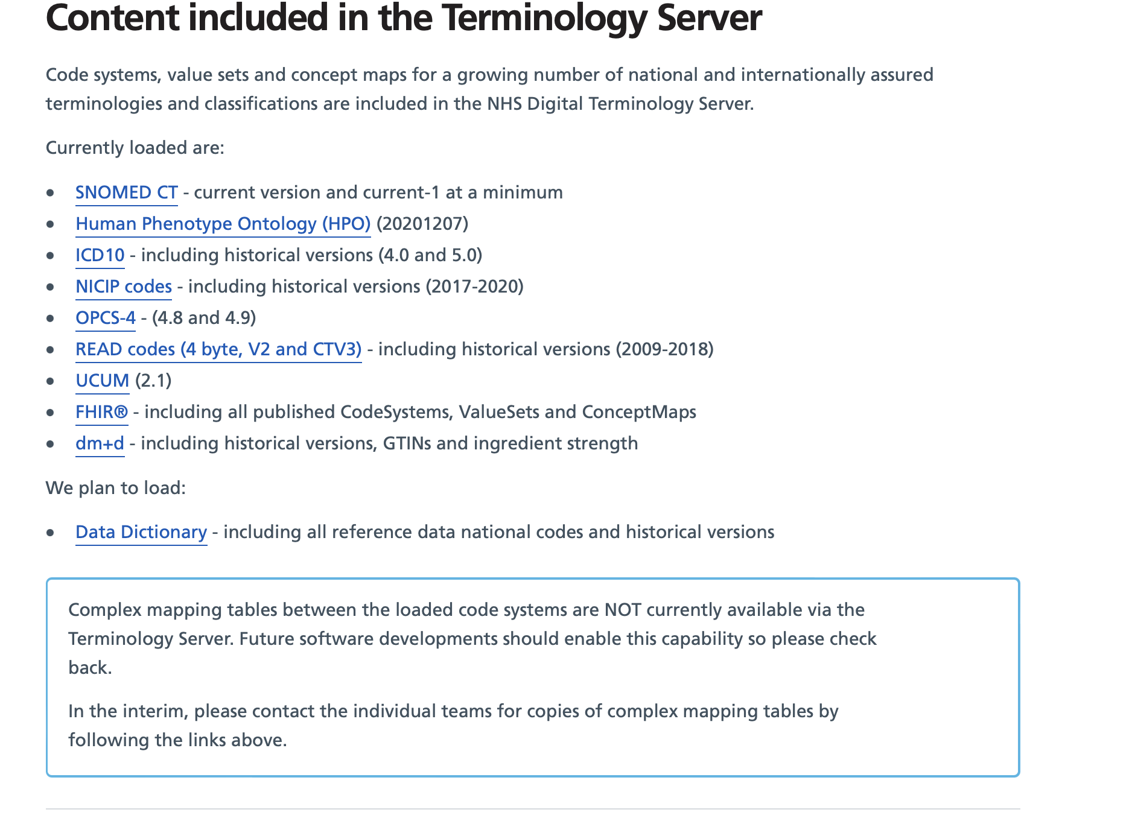
https://digital.nhs.uk/services/terminology-servers#content-included-in-the-terminology-server

Slide 14
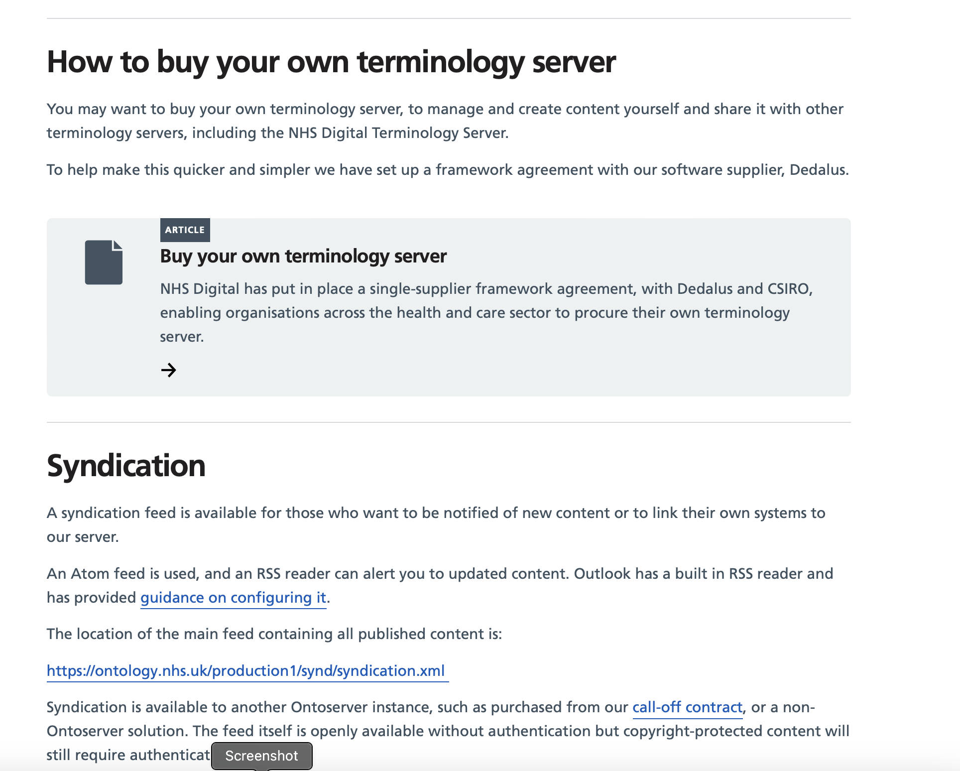
https://digital.nhs.uk/services/terminology-servers#how-to-integrate-your-system

Slide 15
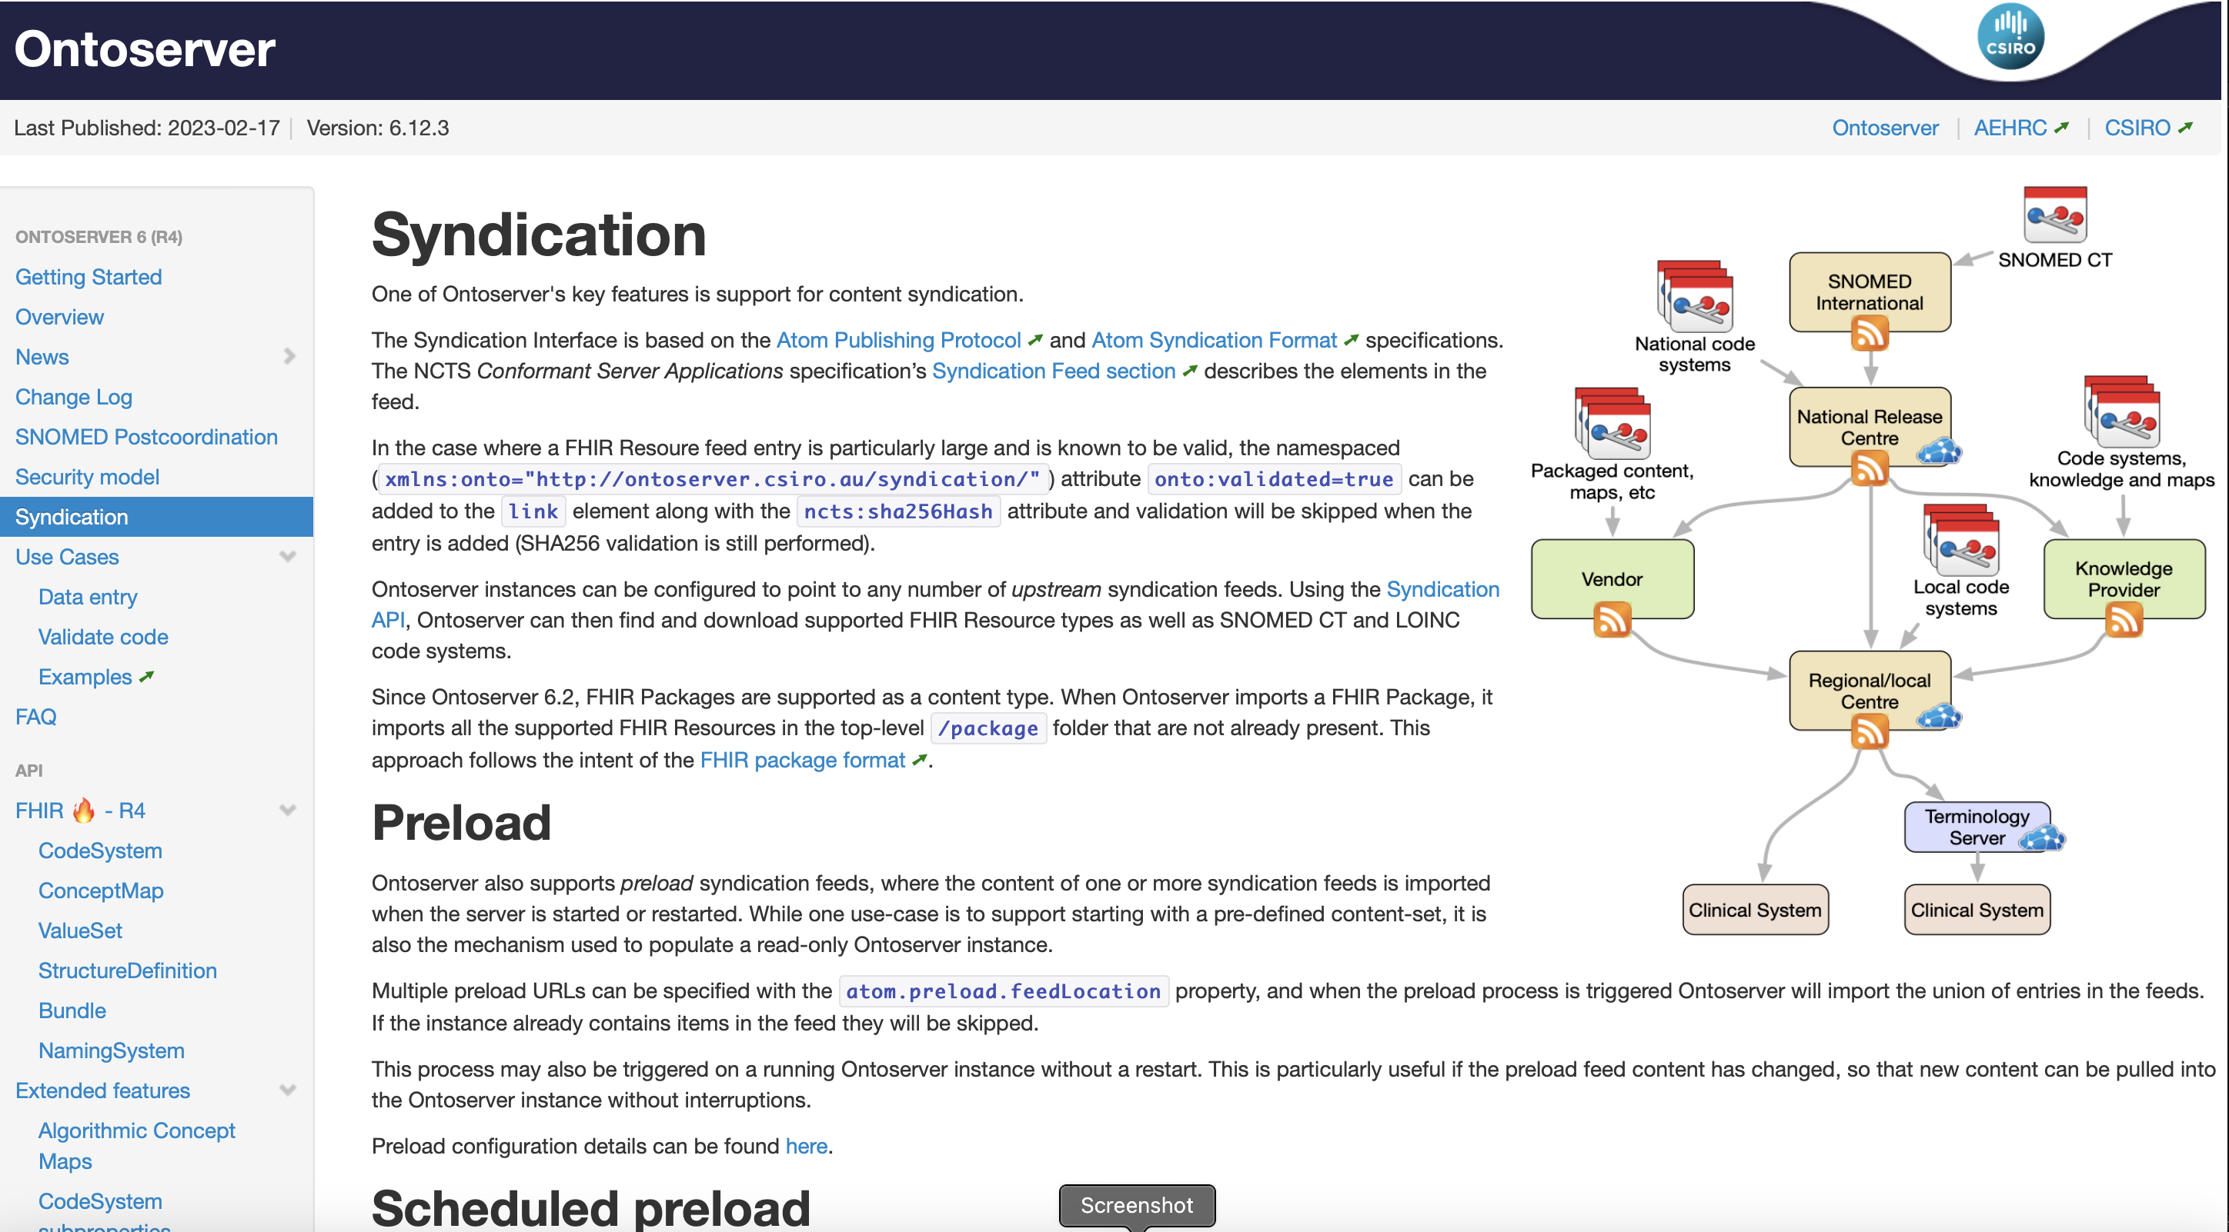

Slide 16
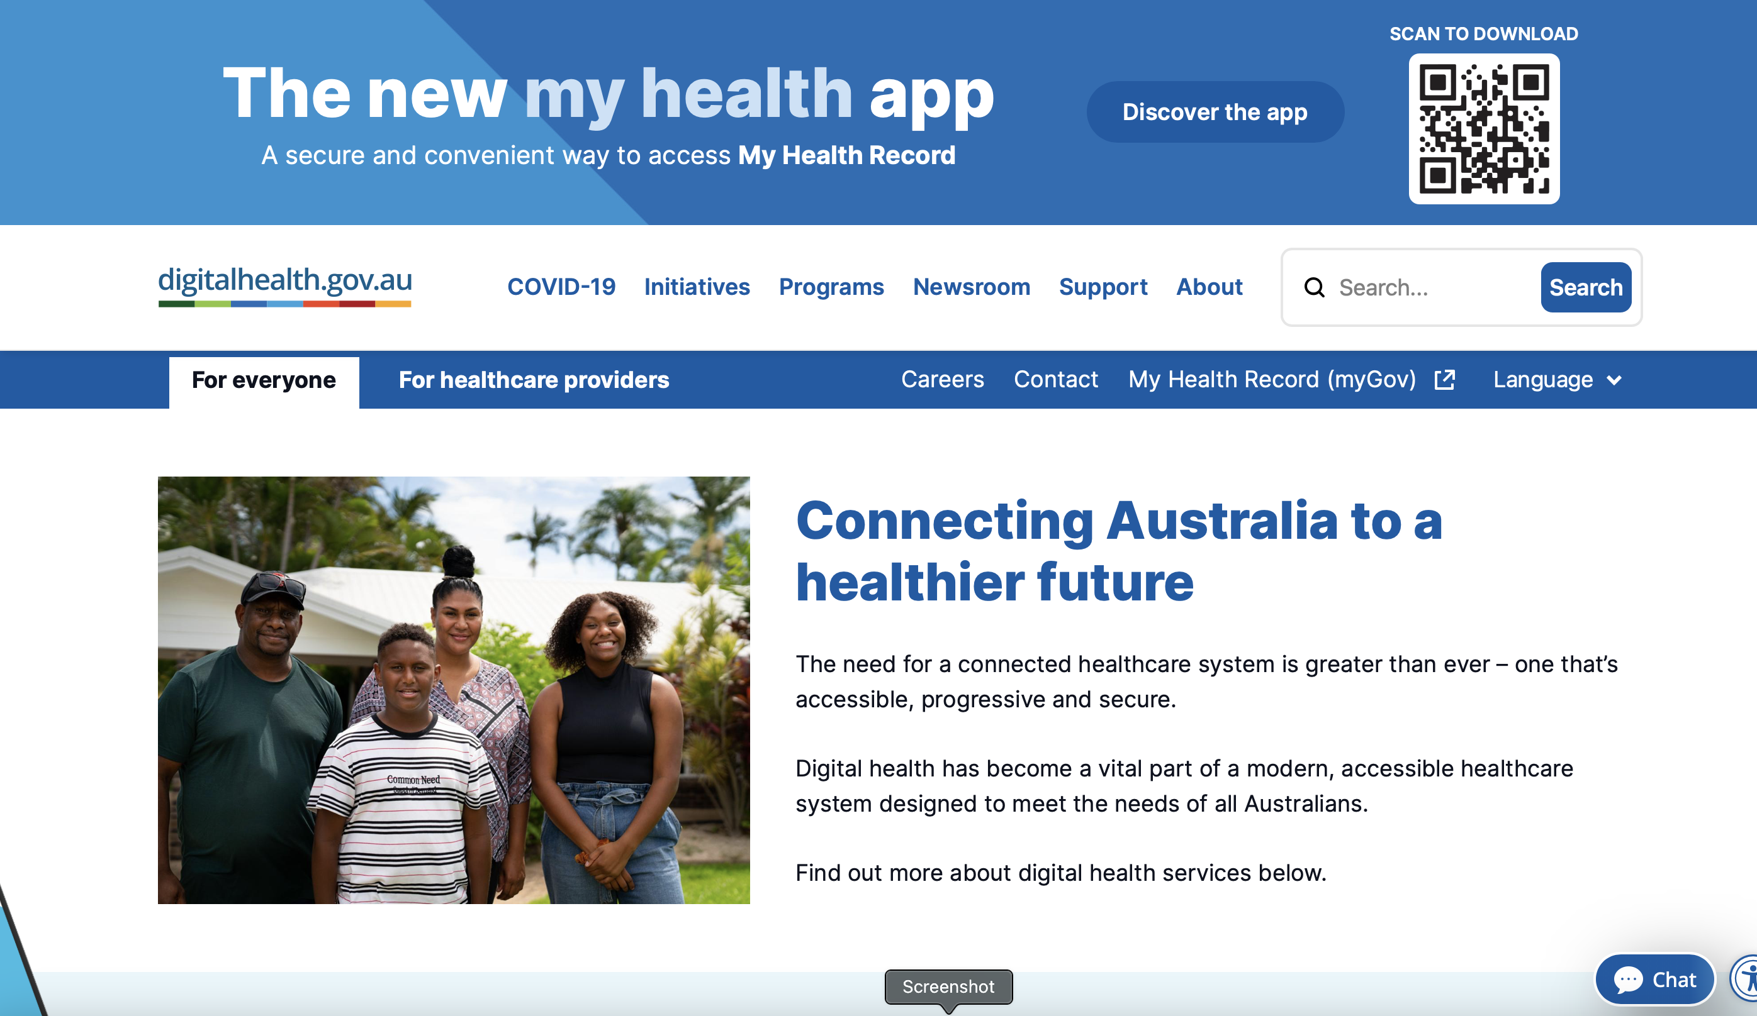
https://www.digitalhealth.gov.au
https://www.digitalhealth.gov.au

Slide 17
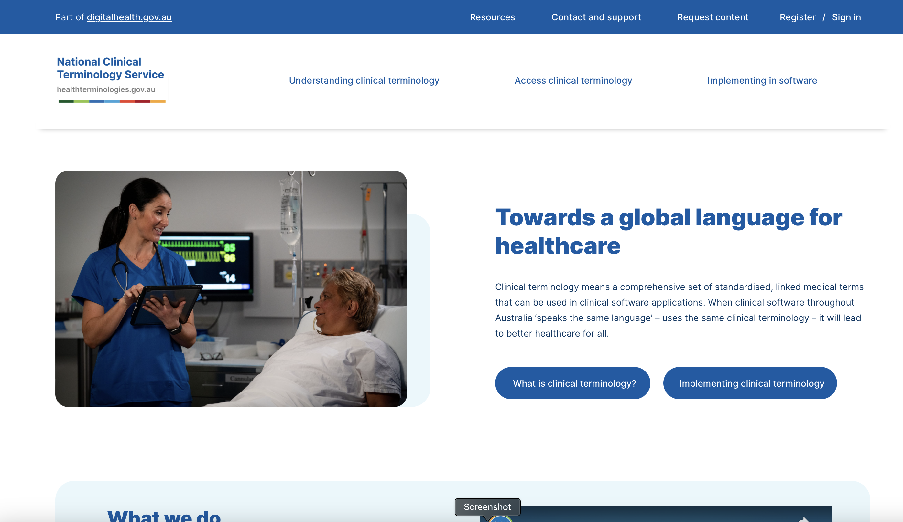
https://www.healthterminologies.gov.au

Slide 18
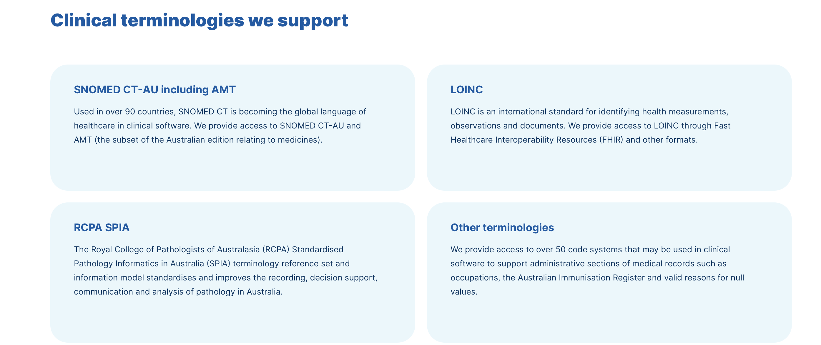

Slide 19
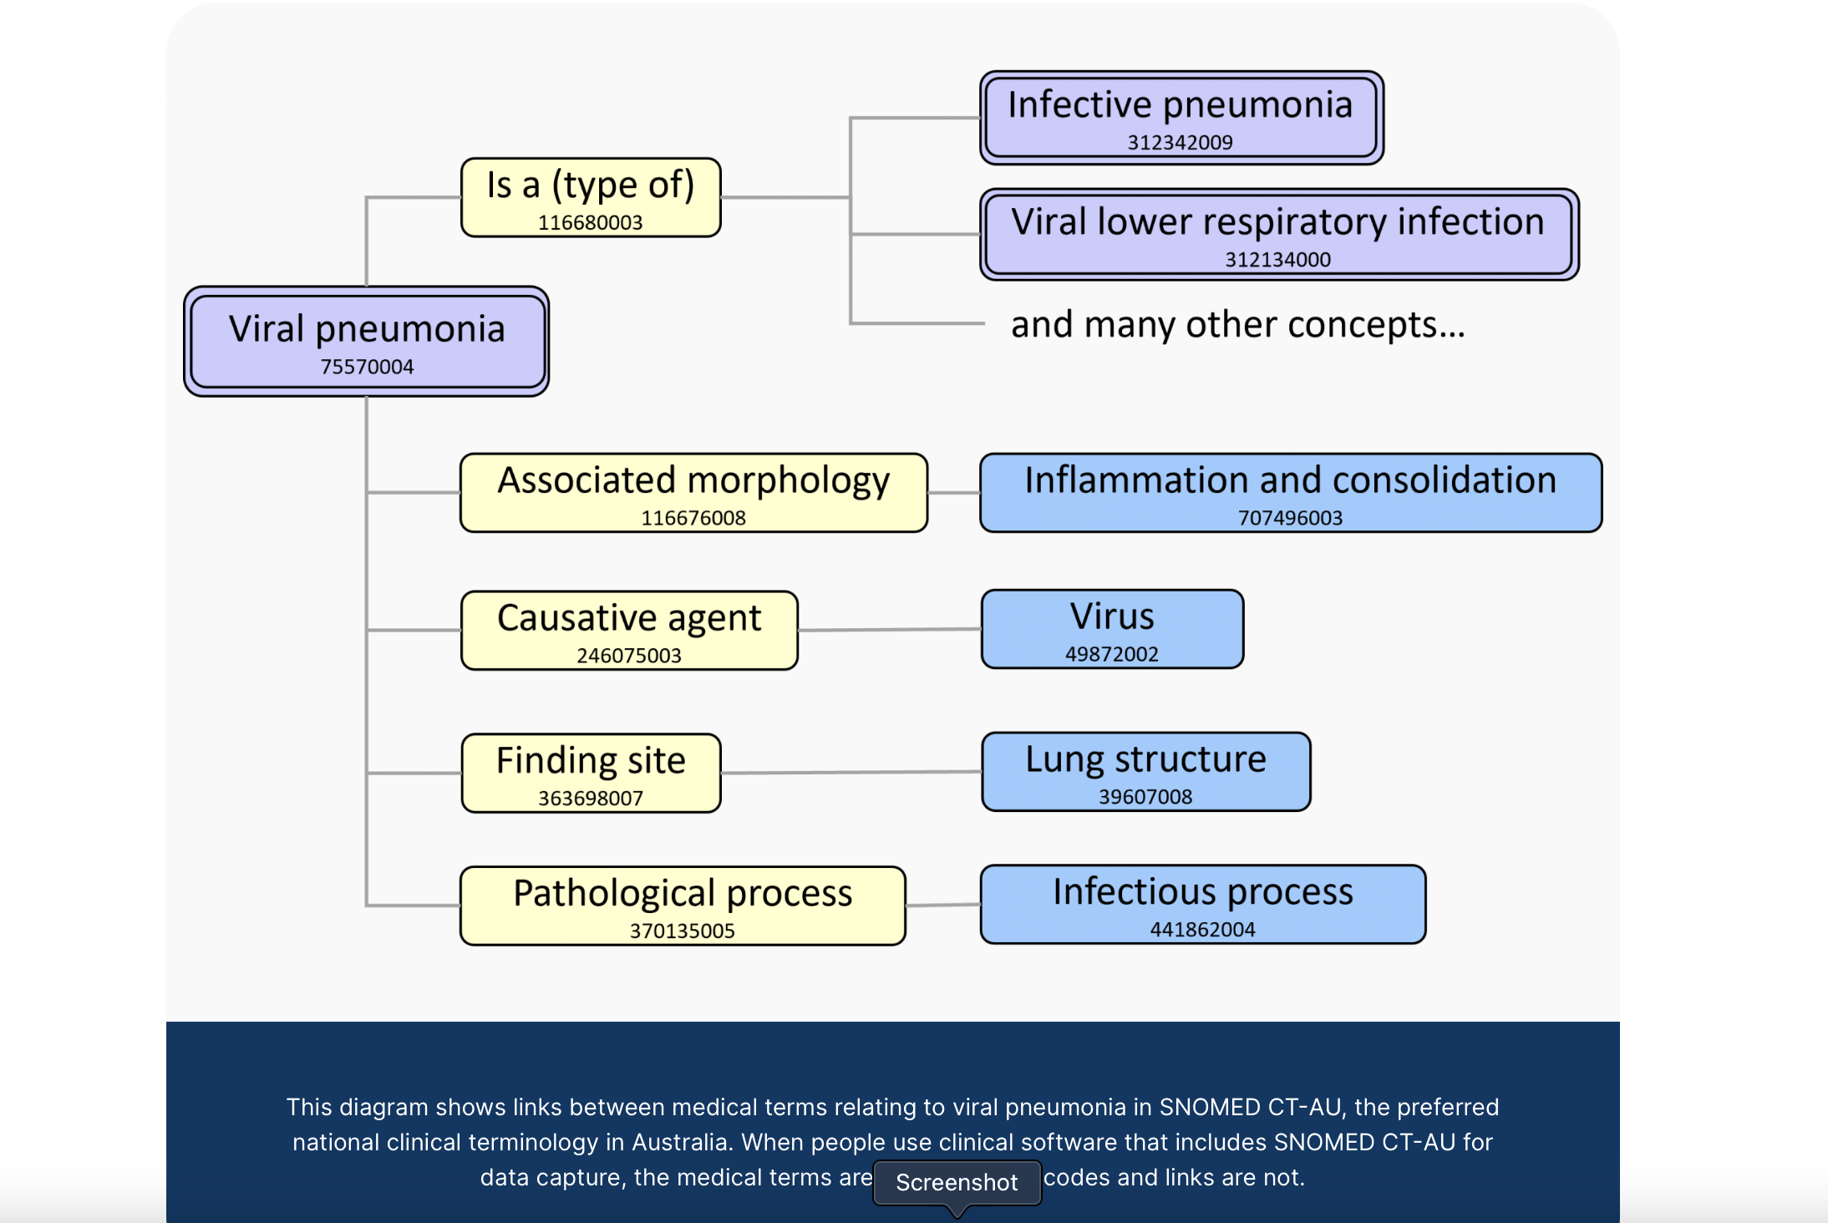

Slide 20
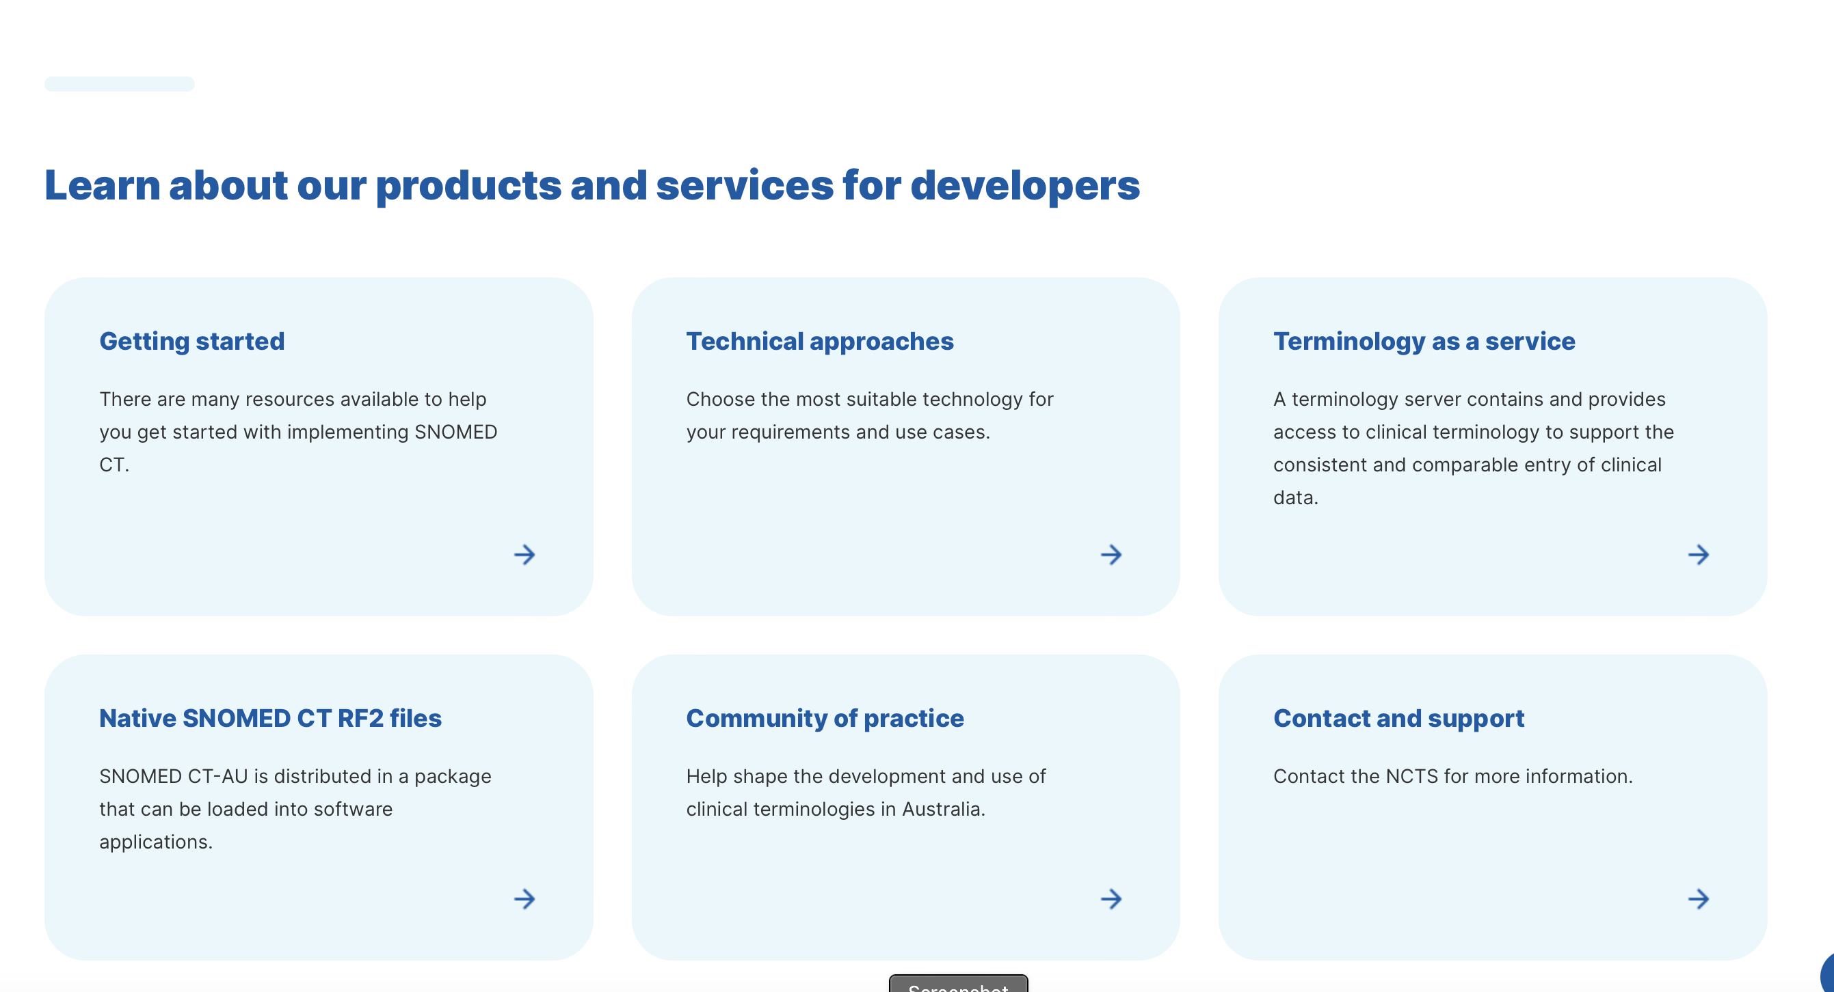
https://www.healthterminologies.gov.au/implementing-in-software/

